Slide 1

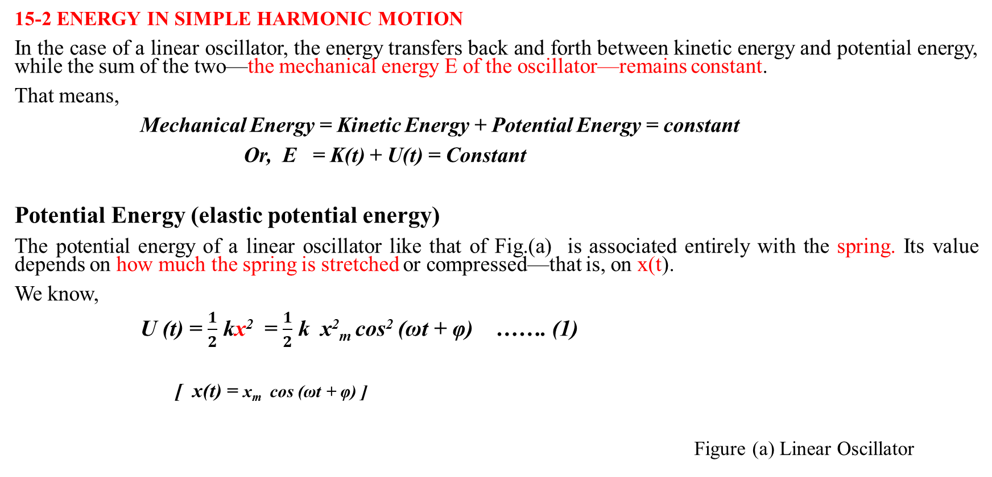
Lecture 14
Chapter 15: Oscillations
15-2 ENERGY IN SIMPLE HARMONIC MOTION
In the case of a linear oscillator, the energy transfers back and forth between kinetic energy and potential energy, while the sum of the two—the mechanical energy E of the oscillator—remains constant.
That means,
Mechanical Energy = Kinetic Energy + Potential Energy = constant
Or, E = K(t) + U(t) = Constant
Potential Energy (elastic potential energy)
The potential energy of a linear oscillator like that of Fig.(a) is associated entirely with the spring. Its value depends on how much the spring is stretched or compressed—that is, on x(t).
We know,
U (t) = $\frac{1}{2}$ kx² = $\frac{1}{2}$ k x²_{m} cos² (ωt + φ) ……. (1)
[ x(t) = x_{m} cos (ωt + φ) ]
Figure (a) Linear Oscillator

Slide 2

Kinetic Energy
The kinetic energy of the system of Figure (a) is associated entirely with the block. Its value depends on how fast the block is moving—that is, on v(t).
We then find,
K (t) = $\frac{1}{2}$ m v² = $\frac{1}{2}$ (m ω²)x²_{m} sin²(ωt + φ) ………. (2)
[ x(t) = x_{m} cos (ωt + φ)
v(t) = - ω x_{m} sin (ωt + φ) ]
ω = $\sqrt{\frac{k}{m}}$
ω² = $\frac{k}{m}$
k = m ω²
Substituting the value of ω² in Eq (2) We get,
K (t) = $\frac{1}{2}$ k x²_{m} sin²(ωt + φ) ………. (3)

Slide 3

Mechanical Energy
The mechanical energy follows from Eqs.1 and 3 and is
E = U(t) + K (t)
= $\frac{1}{2}$ k x²_{m} cos² (ωt + φ) + $\frac{1}{2}$ k x²_{m} sin²(ωt + φ)
= $\frac{1}{2}$ k x²_{m} [ cos² (ωt + φ) + sin²(ωt + φ) ] [sin² α + cos² α = 1]
E = $\frac{1}{2}$ k x²_{m}
The mechanical energy of a linear oscillator is indeed constant and independent of time.

Slide 4
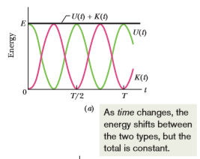


The potential energy and kinetic energy of a linear oscillator are shown as functions of time t in Fig. a
Figure : (a) Potential energy U(t), kinetic energy K(t),and mechanical energy E as functions of time t for a linear harmonic oscillator. Note that all energies are positive and that the potential energy and the kinetic energy peak twice during every period.
U(t)= $\frac{1}{2}$ k x²_{m} cos² (ωt + φ)
K (t) = $\frac{1}{2}$ k x²_{m} sin²(ωt + φ)

Slide 5
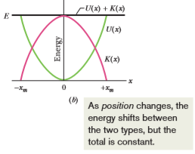


The potential energy and kinetic energy of a linear oscillator are shown as functions of displacement x in Fig. b
Figure (b) Potential energy U(x), kinetic energy K(x),and mechanical energy E as functions of position x for a linear harmonic oscillator with amplitude x_{m .} For x = 0 the energy is all kinetic, and for x = x_{m} it is all potential.
U= $\frac{1}{2}$ k x²
K = $\frac{1}{2}$ m v²

Slide 6
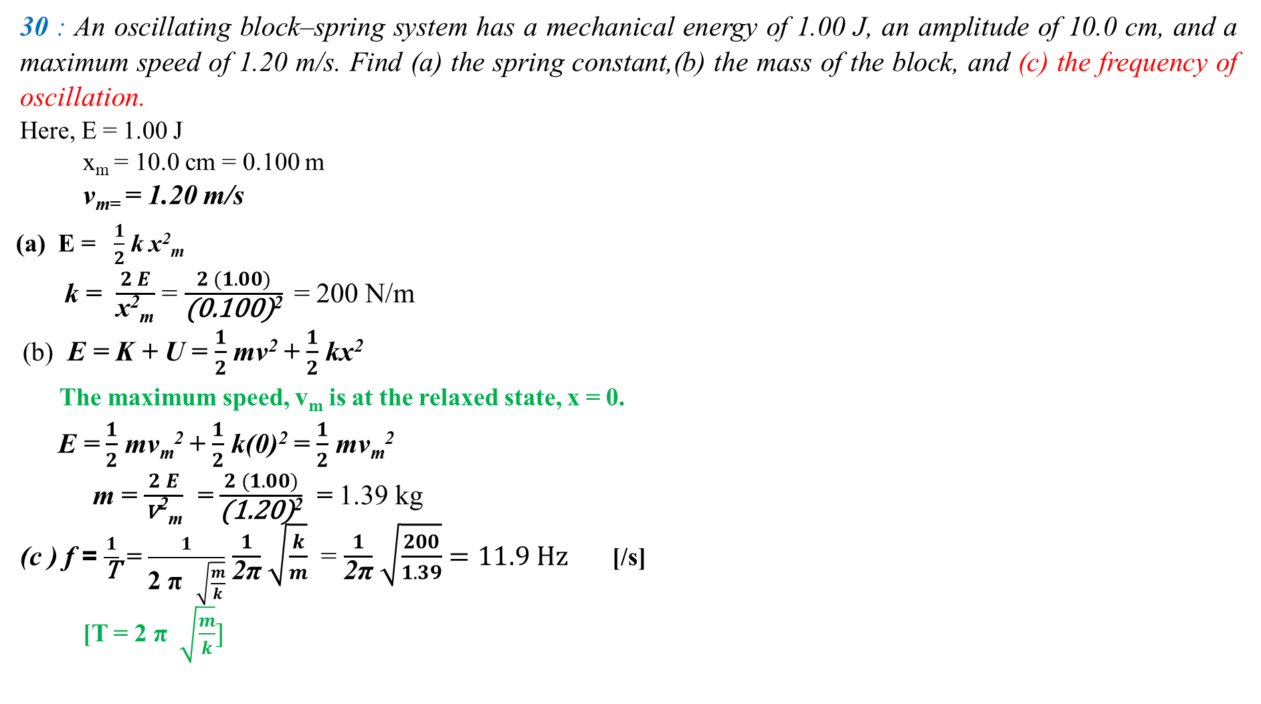
30 : An oscillating block–spring system has a mechanical energy of 1.00 J, an amplitude of 10.0 cm, and a maximum speed of 1.20 m/s. Find (a) the spring constant,(b) the mass of the block, and (c) the frequency of oscillation.
Here, E = 1.00 J
x_{m} = 10.0 cm = 0.100 m
v_{m=} = 1.20 m/s
(a) E = $\frac{1}{2}$ k x²_{m}
k = $\frac{ 2 E }{\text{x}\text{2}\text{m}}$ = $\frac{ 2 (1.00) }{\text{(0.100)}\text{2}}$ = 200 N/m
(b) E = K + U = $\frac{1}{2}$ mv² + $\frac{1}{2}$ kx²
The maximum speed, v_{m} is at the relaxed state, x = 0.
E = $\frac{1}{2}$ mv_{m}² + $\frac{1}{2}$ k(0)² = $\frac{1}{2}$ mv_{m}²
m = $\frac{ 2 E }{\text{v}\text{2}\text{m}}$ = $\frac{ 2 (1.00) }{\text{(1.20)}\text{2}}$ = 1.39 kg
(c ) f = $\frac{1}{\text{T}}$ = $\frac{1}{\text{2} \text{π} \sqrt{\frac{m}{k}}}$ $\frac{ 1 }{\text{2}\text{π}}$ $\sqrt{\frac{k}{m}}$ = $\frac{ 1 }{\text{2}\text{π}}$ $\sqrt{\frac{200}{1.39}}=11.9 Hz$ [/s]
[T = $\text{2} \text{π}$ $\sqrt{\frac{m}{k}}]$

Slide 7
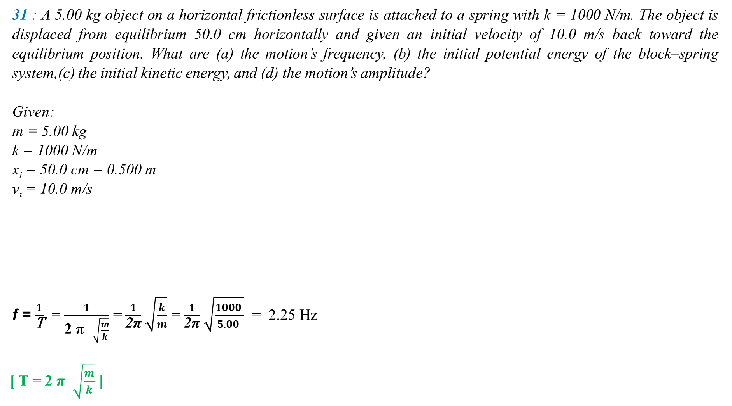
31 : A 5.00 kg object on a horizontal frictionless surface is attached to a spring with k = 1000 N/m. The object is displaced from equilibrium 50.0 cm horizontally and given an initial velocity of 10.0 m/s back toward the equilibrium position. What are (a) the motion’s frequency, (b) the initial potential energy of the block–spring system,(c) the initial kinetic energy, and (d) the motion’s amplitude?
Given:
m = 5.00 kg
k = 1000 N/m
x_{i} = 50.0 cm = 0.500 m
v_{i} = 10.0 m/s
f = $\frac{1}{\text{T}}$ = $\frac{1}{\text{2} \text{π} \sqrt{\frac{m}{k}}}$ = $\frac{ 1 }{\text{2}\text{π}}$ $\sqrt{\frac{k}{m}}$ = $\frac{ 1 }{\text{2}\text{π}}$ $\sqrt{\frac{1000 }{5.00 }}$ = 2.25 Hz
[ T = $\text{2} \text{π}$ $\sqrt{\frac{m}{k}} ]$
x_{m} = 86.6 cm
x_{i} = 50 cm
v_{i} = 10.0 m/s

Slide 8


x_{i} = 50 cm
(b) U_{i} = $\frac{1}{2}$ k x_{i}² = $\frac{1}{2}$ (1000) (0.500)² = 125 J
(c) K_{i} = $\frac{1}{2}$ mv_{i}² = $\frac{1}{2}$ (5) (10)² = 250 J
(d) E = U_{i} + K_{i} = (125 + 250 ) J = 375 J
E = $\frac{1}{2}$ k x²_{m} [x_{m} = amplitude (maximum displacement)]
x_{m} = $\sqrt{\frac{ 2 E}{k }}$ = $\sqrt{\frac{ 2 ( 375 )}{1000 }}$ = 0.866 m = 86.6 cm [E = Constant]
x_{m} = 86.6 cm
v_{i} = 10.0 m/s
E = = $\frac{1}{2}$ k x²_{m} + $\frac{1}{2}$ mv_{m}² = $\frac{1}{2}$ k x²_{m} + $\frac{1}{2}$ m(0)²

Slide 9
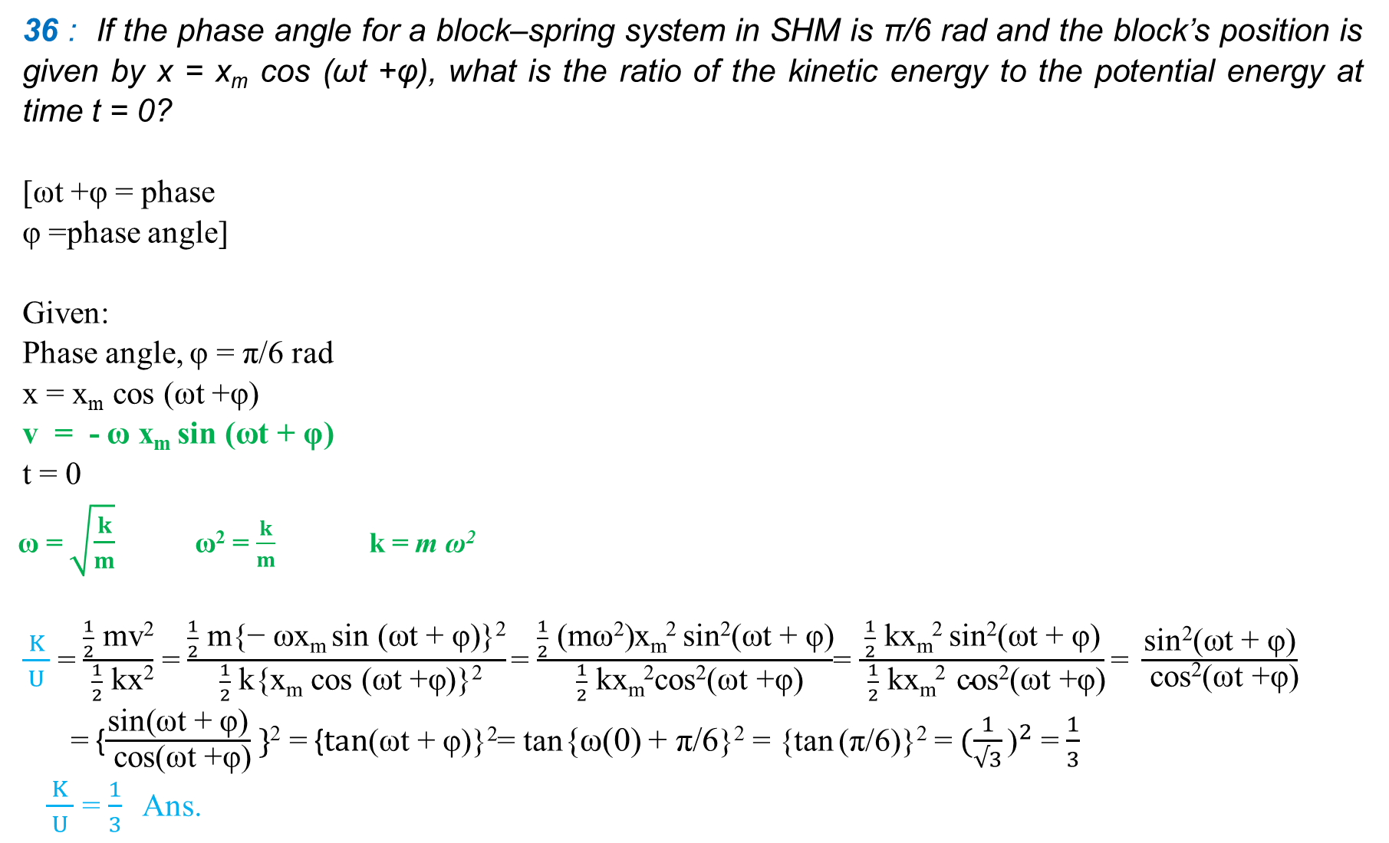
36 : If the phase angle for a block–spring system in SHM is π/6 rad and the block’s position is given by x = x_{m} cos (ωt +φ), what is the ratio of the kinetic energy to the potential energy at time t = 0?
[ωt +φ = phase
φ =phase angle]
Given:
Phase angle, φ = π/6 rad
x = x_{m} cos (ωt +φ)
v = - ω x_{m} sin (ωt + φ)
t = 0
ω = $\sqrt{\frac{k}{m}}$ ω² = $\frac{k}{m}$ k = m ω²
$\frac{ K }{ U }$ = $\frac{\frac{1}{2} \text{mv}\text{2}}{ \frac{1}{2} \text{kx}\text{2}}$ = $\frac{\frac{1}{2} \text{m}\text{\{}\text{− }\text{ωxm} \text{sin}\text{ (}\text{ωt}\text{ + }\text{φ}\text{)\}2}}{ \frac{1}{2} \text{k}\text{\{}\text{x}\text{m} \text{cos}\text{ (}\text{ωt}\text{ +}\text{φ}\text{)\}2}}$= $\frac{\frac{1}{2} \text{(}\text{mω}\text{2}\text{)}\text{x}\text{m}\text{2} \text{sin}\text{2}\text{(}\text{ωt}\text{ + }\text{φ}\text{)}}{ \frac{1}{2} \text{kxm}\text{2}\text{cos}\text{2}\text{(}\text{ωt}\text{ +}\text{φ}\text{)}}$= $\frac{\frac{1}{2} \text{k}\text{x}\text{m}\text{2} \text{sin}\text{2}\text{(}\text{ωt}\text{ + }\text{φ}\text{)}}{ \frac{1}{2} \text{kxm}\text{2} \text{c}\text{os}\text{2}\text{(}\text{ωt}\text{ +}\text{φ}\text{)}}\text{= }\frac{\text{sin}\text{2}\text{(}\text{ωt}\text{ + }\text{φ}\text{)}}{ \text{cos}\text{2}\text{(}\text{ωt}\text{ +}\text{φ}\text{)}}$
= {$\frac{\text{sin}\text{(}\text{ωt}\text{ + }\text{φ}\text{)}}{ \text{cos}\text{(}\text{ωt}\text{ +}\text{φ}\text{)}} \}$² = {$\text{t}\text{an}\text{(}\text{ωt}\text{ + }\text{φ}\text{)\}2}$= tan{ω(0) + π/6}² = {tan (π/6)}² =${ (\frac{1}{√3}\text{)}}^{2}$= $\frac{1}{3}$
$\frac{ K }{ U }$ = $\frac{1}{3}$ Ans.

